Slide 1

Unit-1: Introduction to Computer Networks & Internet
Computer Networks (CN)
GTU #3150710
Prof. Maulik D Trivedi
Computer Engineering
maulik.trivedi@darshan.ac.in
+91-9998265805

Slide 2

Looping
Outline
What is Computer Network?
Advantages of Computer Network
Applications of Computer Network
Type of Computer Network
What is Internet?
The Network Edge & The Network Core
Transmission Media
Network Topologies
Protocol Layers
Delay, Loss & Throughput

Slide 3
What is Computer Network?
Computer Network is a system in which multiple computers are connected to each other to share information and resources.
Network
Devices
Wireless
Computers
Wired

Slide 4


Advantages of Computer Network
File Sharing
Flexible Access
Better Communication
Entertainment

Slide 5
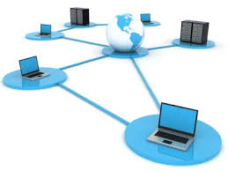
Advantages of Computer Network
Internet Access
Inexpensive System
Instant and Multiple Access
Resource Sharing

Slide 6




Applications of Computer Network
Email Services
Teleconferencing
Business & Finance
File & Directory Services
& Many More….

Slide 7
Types of Computer Network
Computer networks can be categories by their size as well as their purpose.
The size of a network can be expressed by the geographic area.
Some of the different networks based on size are:
Network
Local Area Network
(LAN)
Metropolitan Area Network
(MAN)
Wide Area Network
(WAN)

Slide 8

Local Area Network
A local area network (LAN) is a computer network that interconnects computers within a limited area such as a residence, school, laboratory, university campus or office building.

Slide 9
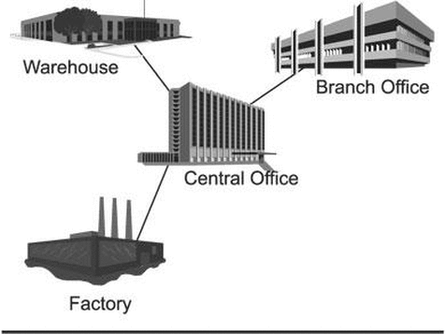
Metropolitan Area Network
A metropolitan area network (MAN) is a computer network that interconnects with computer in a metropolitan area like city.
MAN is a larger than LAN but smaller than the area covered by a WAN.
It is also used to interconnection of several local area network.
Navagam
Morbi
Rajkot
Shapar

Slide 10
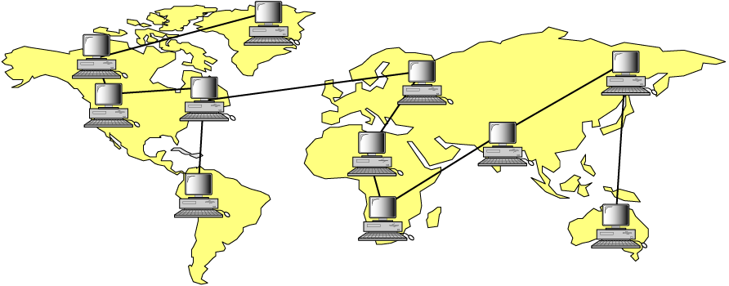
Wide Area Network
A wide area network (WAN) is a computer network that exists over a large-scale geographical area.
A WAN connects different networks, including local area networks (LAN) and metropolitan area networks (MAN).
It may be located with in a state or a country or it may be interconnected around the world.
Asia
America
Africa

Slide 11
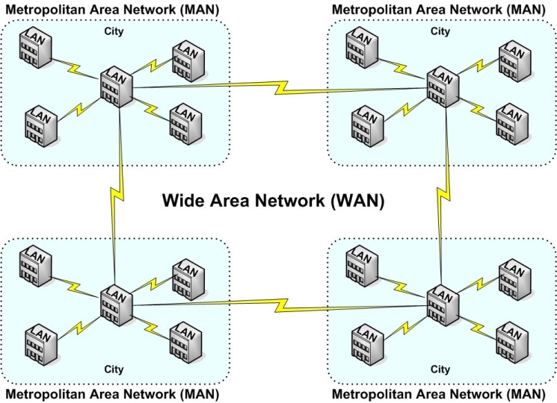
Types of Computer Networks - Summary

Slide 12
Types of Computer Networks - Summary
Comparison | LAN | MAN | WAN
Full Name | Local Area Network | Metropolitan Area Network | Wide Area Network
Meaning | A network that connects a group of computers in a small geographical area | It covers relatively large region such as cities, towns | It spans large locality & connects countries together. e.g. Internet
Ownership of Network | Private | Private or Public | Private or Public (VPN)
Design and Maintenance | Easy | Difficult | Difficult
Propagation Delay | Short | Moderate | Long
Speed | High | Moderate | Low
Equipment Used | NIC, Switch, Hub | Modem, Router | Microwave, Radio Transmitter & Receiver
Range(Approximately) | 1 to 10 km | 10 to 100 km | Beyond 100 km
Used for | College, School, Hospital | Small towns, City | State, Country, Continent

Slide 13





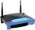




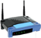


What is Internet?
The internet is a type of world-wide computer network.
The internet is the collection of infinite numbers of connected computers that are spread across the world.
Mobile Network
Network Components
Global ISP
PC
Home
Network
server
Regional ISP
wireless
links
wireless
laptop
Wired link
smartphone
router
Institutional
Network

Slide 14
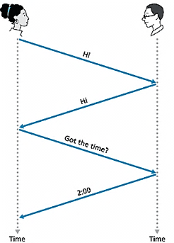
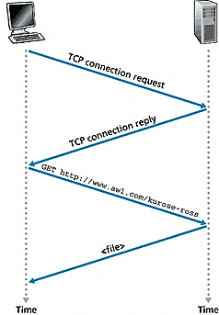
What is Protocol?
Network Protocol
Set of rules
Machines rather than humans.
All communication activity in Internet governed by protocols.
Human Protocol(Language)
“what’s the time?”
“I have a question”
Introduction Talk
Protocol is define format, order of message that sent and received among network entities, and actions taken on message transmission and reception.

Slide 15




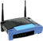


The Network Edge
Computers and other devices are connected at the edge (end) of the network.
These computers are known as hosts or end systems. Router is known as edge router.
mobile network
Global ISP
Home
Network
Regional ISP
Institutional
Network

Slide 16


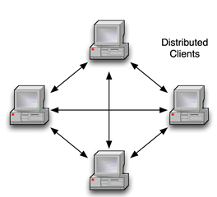
Peer to Peer Network
Computers are connected together so that users can share resources and information.
There is no central server for authenticating users, each of them works as both client and server.
e.g. Bit Torrent

Slide 17
Client – Server Network
Client: Request servers for a task.
Generally called desktop PCs or workstations.
Server: Receive requests from the clients. Process and response them.
e.g. Web Server, Email Server

Slide 18
The Network Core
Defines the connection of different network segments together and process to transmit data packets across the network.
It is implemented through the use of switching techniques.
Switched
Networks
Circuit-Switched
Networks
Packet-Switched
Networks

Slide 19
Circuit Switched Network
A dedicated channel has to be established before the call is made between users.
The channel is reserved between the users till the connection is active.
For half duplex(one way) communication, one channel is allocated and for full duplex(two way) communication, two channels are allocated.
It is mainly used for voice communication requiring real time services without delay.

Slide 20
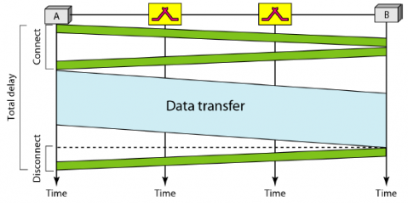
Circuit Switched Network – Cont…
Communication via circuit switching involves three phases:
Circuit Establishment
Data Transfer
Circuit Disconnect

Slide 21
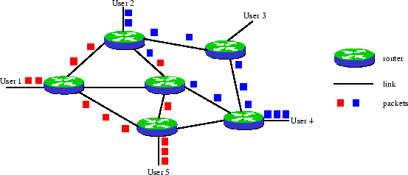
Packet Switched Network
It is not required to establish the connection initially.
The connection/channel is available to use by users. But when traffic or number of users increases then it will lead to congestion in the network.
Packet switched networks are mainly used for data and voice applications requiring non-real time scenarios.

Slide 22
Differences
Circuit Switching | Packet Switching
Dedicated path between source and destination | No dedicated path
All packets use same path | Packets travel independently
Reserve the entire bandwidth in advance | Does not reserve bandwidth
Bandwidth wastage | No bandwidth wastage
No store and forward transmission | Supports store and forward transmission

Slide 23
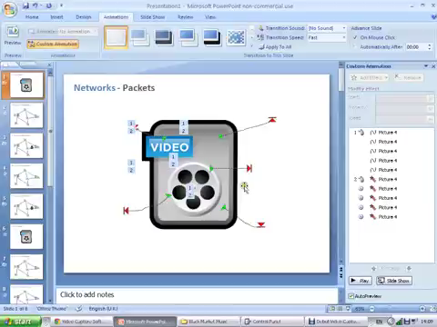
Switching Network

Slide 25
Transmission Media

Slide 26
Transmission Media
A transmission media can be defined as any medium that can carry information from a source to a destination.
Transmission Media
Guided Media (Wired)
Unguided Media (Wireless)
Twisted-Pair Cable
Coaxial Cable
Fiber Optic Cable
Radio Wave
Microwave
Infrared Wave

Slide 27
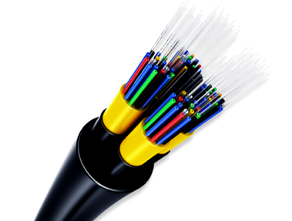
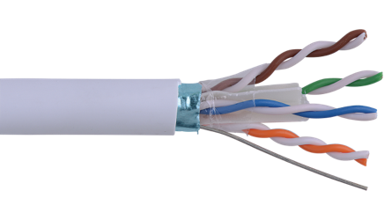
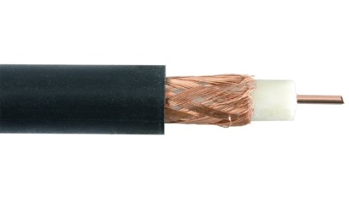
Guided Media
Guided media are those that provide a wired - channel from one device to another.
Three Guided media commonly used for data transmission are:
Twisted Pair Cable
Coaxial Cable
Fiber Optic Cable

Slide 28
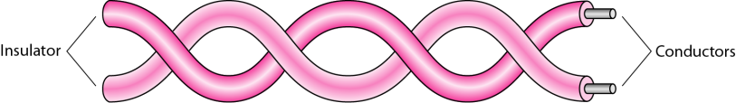
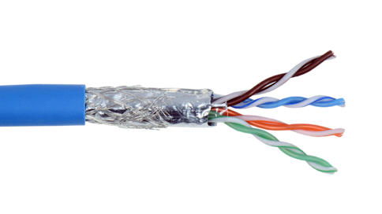
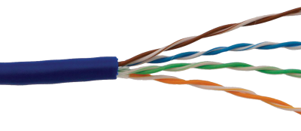
Twisted Pair Cable
Separately insulated
Twisted together
It is widely used in different kinds of data and voice infrastructure.
The use of two wires twisted together helps to reduce crosstalk and electromagnetic induction.
Two types of twisted pair cable:
UTP
(Unshielded Twisted Pair)
STP
(Shielded Twisted Pair)

Slide 29
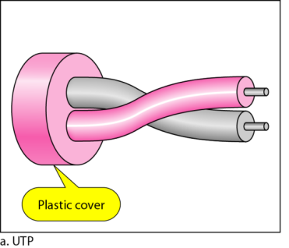
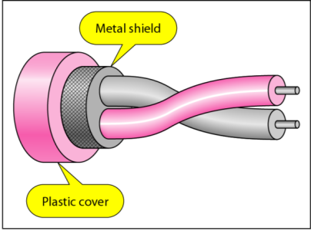
Twisted Pair Cable – Cont…
UTP(Unshielded Twisted Pair)
Ordinary telephone wires
Less expensive
Weak immunity against noise & interferences
Most used in two categories: Cat-3 & Cat-5
Used in laboratory
STP(Shielded Twisted Pair)
An extra metallic shield on each pair
Relatively more expensive
Better performance than UTP
Used in exterior network(outside of building).

Slide 30
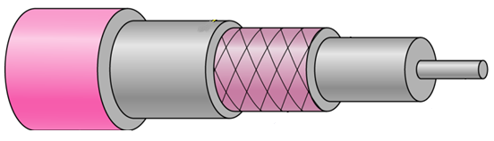
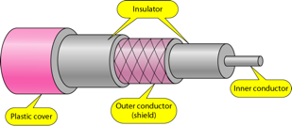
Coaxial Cable
Outer conductor is braided shield.
Inner conductor is solid metal.
Separated by insulating material, and whole cover by plastic cover.
Used in television, long distance telephone transmission.
High bandwidth and excellent noise immunity.
Insulator
Inner Conductor
Plastic cover
Outer conductor (shield)

Slide 31
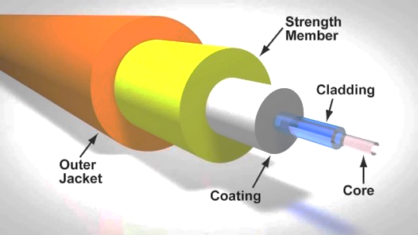
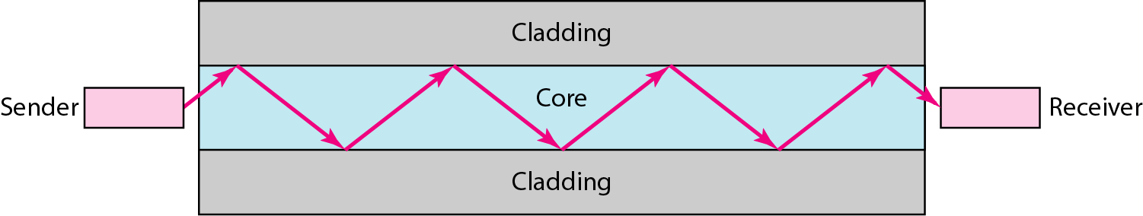
Fiber Optic Cable
A fiber-optic cable is made of glass or plastic and transmits signals in the form of light.
Light travels in a straight line as long as it is moving through a single uniform substance.
It is surrounded by a cladding of less dense glass or plastic so, difference in density of the two materials must be such that a beam of light moving through the core is reflected off the cladding instead of being refracted into it.
It use reflection to guide light through a channel.
Small size & Weight
Used in high bandwidth network
High data rate & lower attenuation

Slide 32
Unguided Media
Unguided media transmit electromagnetic waves without using a physical conductor.
This type of communication is often referred to as wireless communication.
Radio wave
Microwave
Infrared Wave

Slide 33
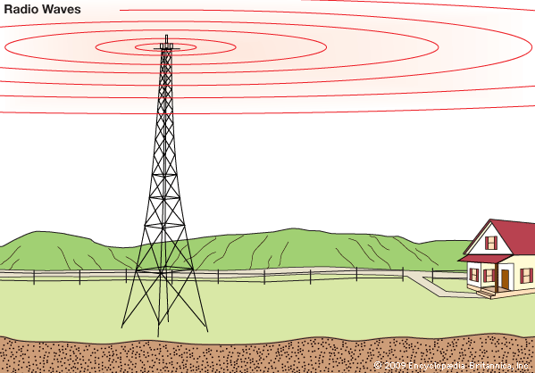
Radio wave
Highly regulated
Omni directional antennas
Penetrate through walls
The sending and receiving antennas need not be aligned.
Frequency Range:3KHz – 1GHz.
It used for multicast communications, AM and FM radios and cordless phones use Radio waves for transmission.
Categorized as (i) Terrestrial and (ii) Satellite.

Slide 34
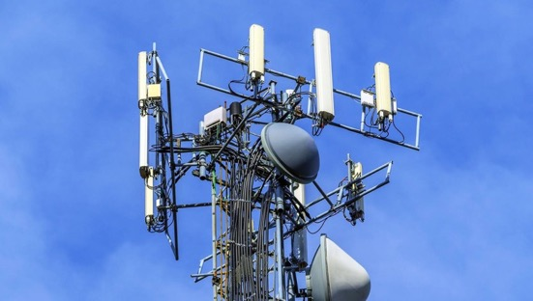
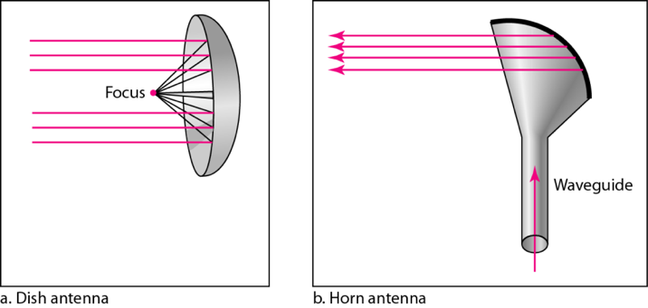
Microwave
Use directional antennas - point to point line of sight communications.
Microwave communication.
Used for unicast communication such as cellular telephones, satellite networks.
Higher frequency ranges cannot efficiently penetrate walls.
Frequency Range: 1GHz – 300GHz.

Slide 35

Infrared wave
Infrared signals can be used for short-range communication in a closed area using line-of-sight propagation
Used on televisions, VCRs, and stereos all use infrared communication.
Relatively directional
Cheap, easy to build but they do not pass through solid objects

Slide 36
Network Topologies

Slide 37
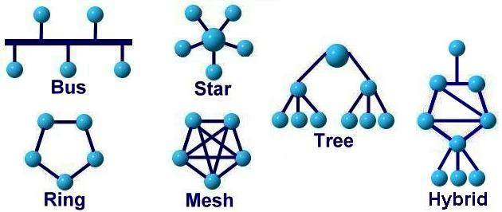
Network Topologies
Network topology is the arrangement of the various components (links, nodes, etc.) of a computer network.
Types of network topologies :
Bus
Ring
Star
Mesh
Tree
Hybrid

Slide 38
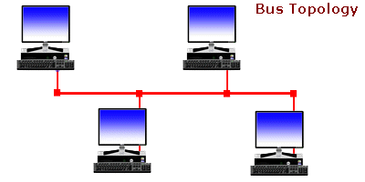
Bus Topology
Every computer and network device is connected to single cable
It transmits data only in one direction.
Cost effective
Used in small networks
Easy to expand joining two cables together
It is used in early LAN connection

Slide 39
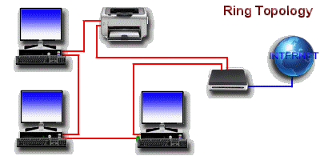
Ring Topology
It forms a ring as each computer is connected to another computer, with the last one connected to the first.
Transmission is unidirectional & sequential way that is bit by bit.
Transmitting network is not affected by high traffic or by adding more nodes, as only the nodes having tokens can transmit data.
Cheap to install and expand.

Slide 40
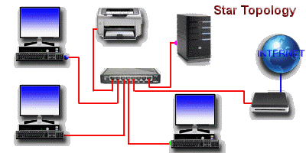
Star Topology
Computers are connected to a single central hub through a cable.
Fast performance with few nodes and low network traffic.
Easy to troubleshoot & Easy to setup and modify.
Only that node is affected which has failed rest of the nodes can work smoothly.
Hub can be upgraded easily.

Slide 41
Mesh Topology
Point-to-point connection to other devices or fully connected.
Traffic is carried only between two connected devices.
Robust, costly but not flexible.
Fault is diagnosed easily.
More cable resource used in setup.

Slide 42
Tree Topology
It has a root node and all other nodes are connected to it forming a hierarchy.
Also called hierarchical topology.
Mostly used in Wide Area Network – WAN.
Expansion of nodes is possible and easy.
Easily managed and maintained.

Slide 43
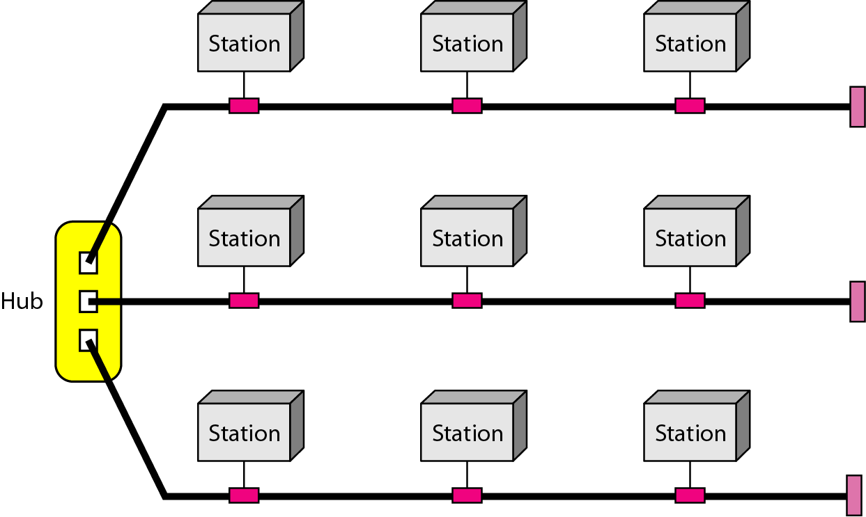
Hybrid Topology
A network structure whose design contains more than one topology is said to be hybrid topology.
It is a combination of two or more topologies.
Flexible & reliable as error detection and easy to troubleshoot.
Scalable as size can be increased easily.

Slide 44
Comparison of Topologies
 | Bus | Ring | Star | Mesh | Tree
Means | every computer and network device is connected to single cable. | Each computer is connected to another, with the last one connected to the first. | All the computers are connected to a single hub through a cable. | All the network nodes are connected to each other. | It has a root node and all other nodes are connected to it forming a hierarchy.
Cost | Average | Cheap | High | High | High
Used in | Small Network | Expand Network | Small Network | Expand Network | Expand Network
Troubleshoot | Easy, But Cables fail then whole network fails. | Difficult; Failure of one computer disturbs the whole network. | Easy; If the hub fails then the whole network is down. | Difficult; Installation and configuration is difficult. | Easy; Central root hub fails, network fails.

Slide 45
Protocol Layers

Slide 46
Protocols Layers
To deals with connecting systems that are open for communication with other systems.
OSI Layer Model (Open Systems Interconnection)
Developed by the International Standards Organization (ISO) with seven different layers.
Physical Layer
Data Link Layer
Network Layer
Transport Layer
Session Layer
Presentation Layer
Application Layer

Slide 47
Example – Air Plane Travel
Departure
Arrival
ticket (purchase)
baggage (check)
gates (load)
runway takeoff
airplane routing
ticket (complain)
baggage (claim)
gates (unload)
runway landing
airplane routing
airplane routing

Slide 48
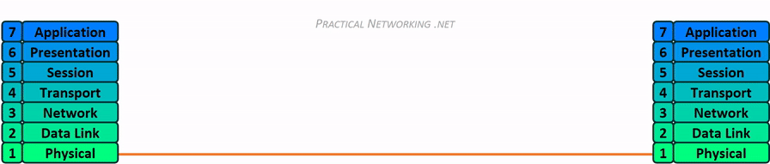

How OSI Layer Works?

Slide 49
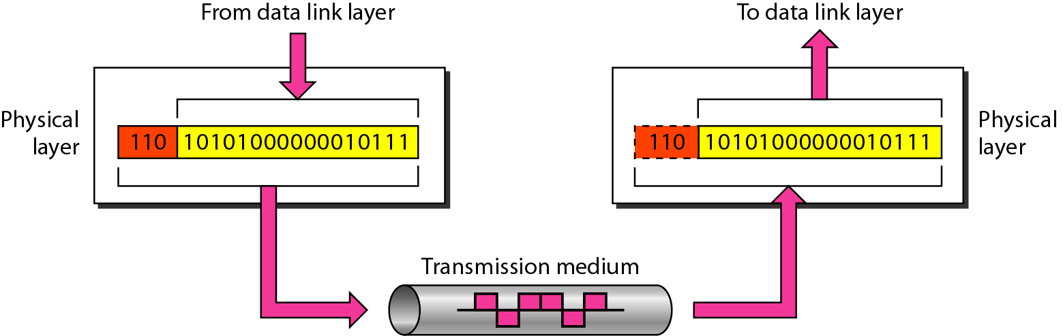
Physical Layer
The physical layer is responsible for movements of individual bits from one hop (node) to the next.

Slide 50
Physical Layer – Cont…
Carries the bit stream over a physical media.
Physical Layer is concerned with:
Interface and Medium like guided cables
Representation of bits
Data rate
Synchronization of bits
Line configuration
Physical topology
Transmission mode

Slide 51
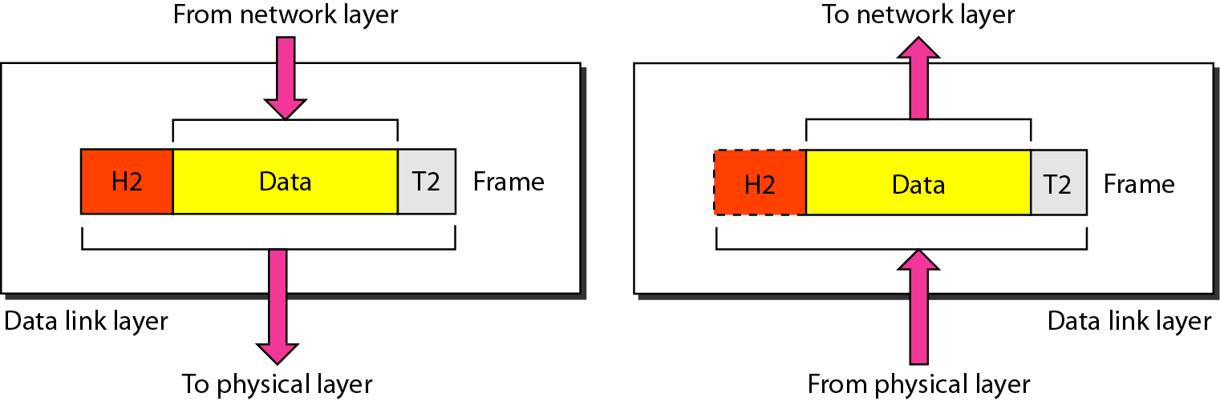
Data Link Layer
The data link layer is responsible for moving frames from one hop (node) to the next.

Slide 52
Data Link Layer – Cont…
Data link layer is concerned with:
Framing – divide bits stream into data unit (frame)
Physical addressing
Flow control – avoid over overwhelming
Error control – bit loses, retransmission
Access control

Slide 53
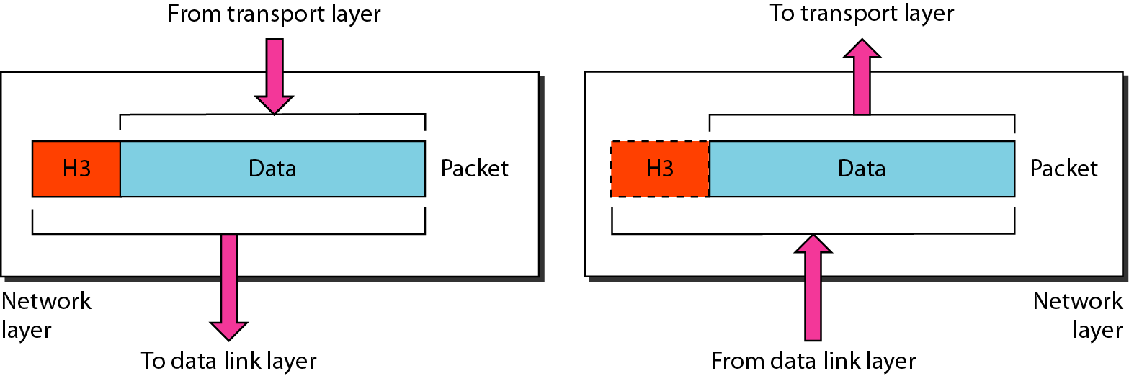
Network Layer
The network layer is responsible for the delivery of individual packets from the source host to the destination host.

Slide 54
Network Layer – Cont…
In this layer, packet is combined with header and data.
In case of data link layer, packet delivers on the same network.
If two different networks are connected then packet is concern with network layer.
Network layer is concerned with:
Logical addressing e.g. 192.168.1.1 (IP Address)
Routing

Slide 55
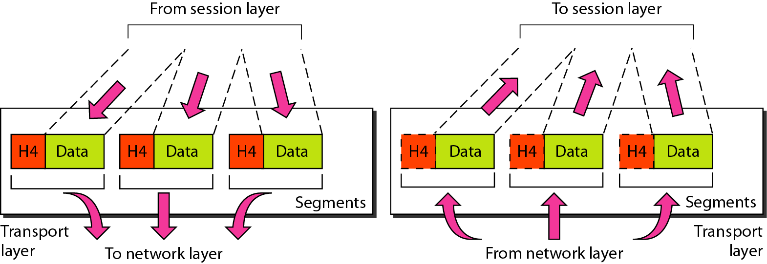
Transport Layer
The transport layer is responsible for the delivery of a message from one process to another.

Slide 56
Transport Layer – Cont…
This layer ensures that the whole message arrives intact and in order.
Transport layer is concerned with:
Service-point addressing (port address)
Segmentation and Reassembly
Connection Control
Flow and Error Control

Slide 57
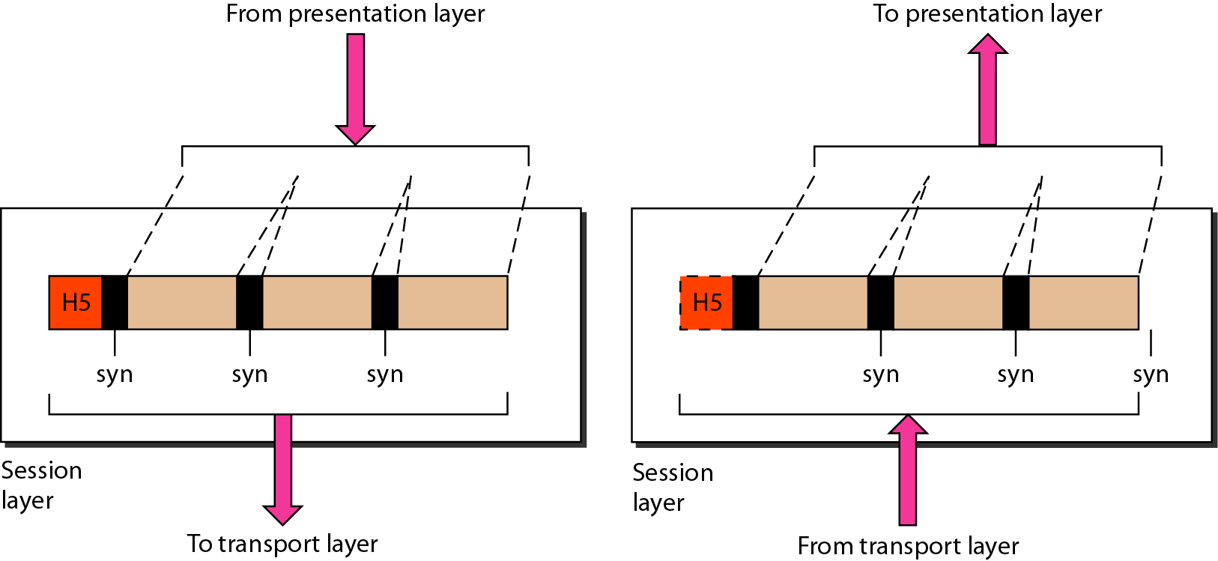
Session Layer
The session layer is responsible for dialog control and synchronization.

Slide 58
Session Layer – Cont…
This layer is network dialog controller – establishes, maintains, synchronizes the interaction among computers.
Session layer is concerned with:
Dialog control
Synchronization

Slide 59
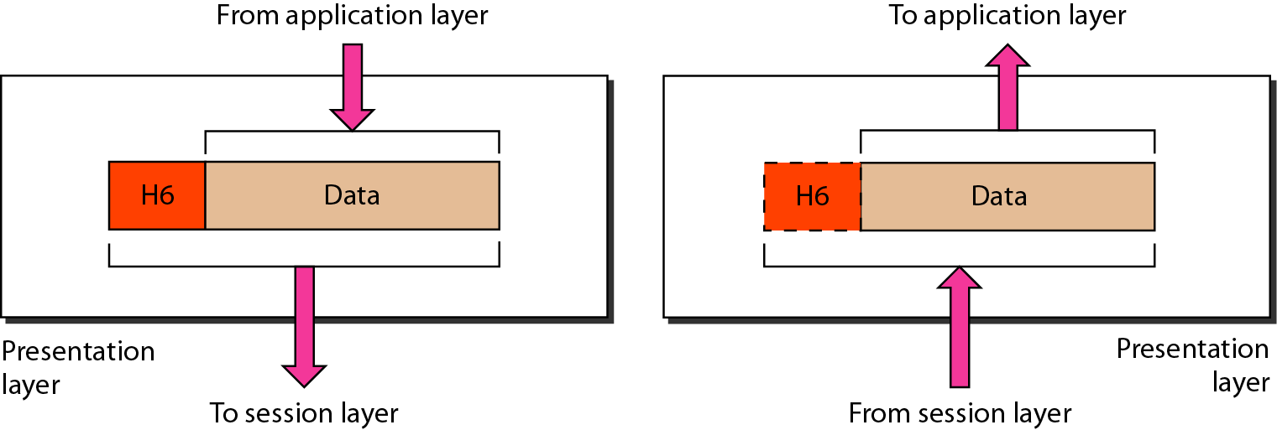
Presentation Layer
The presentation layer is responsible for translation, compression, and encryption.

Slide 60
Presentation Layer – Cont…
This layer is concerned with the syntax which refers to order in which data is presented and semantics helps in interpreting a particular pattern.
Presentation layer is responsible for:
Translation
Encryption
Compression

Slide 61
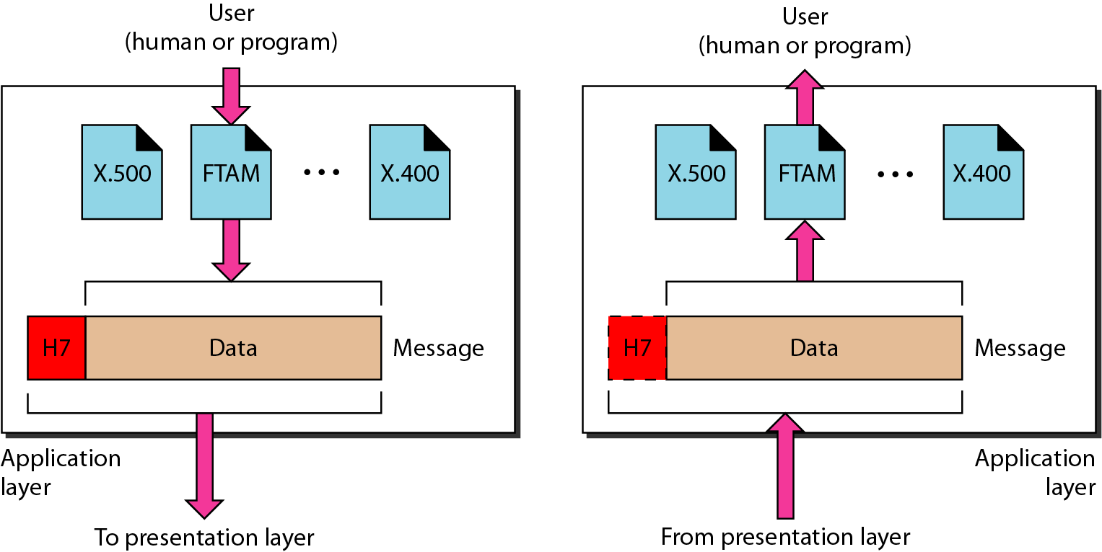
Application Layer
The application layer is responsible for providing services to the user.

Slide 62
Application Layer – Cont…
This layer provides various services like:
Network virtual terminal
File transfer, access and management
Mail services
Directory services

Slide 63
Summary – OSI Layer
To allow access to network resource
Application
To translate, encrypt and compress data
Presentation
To establish, manage and terminate sessions
To provide reliable process-to-process message delivery and error recovery
Session
Transport
To move packets from source to destination; To provide internetworking
Network
To organize bits into frames; To provide hop-to-hop delivery
Data link
To transmit bits over a medium; To provide mechanical & electrical specification
Physical

Slide 64
TCP/IP Reference Model (Transmission Control Protocol/Internet Protocol)
It was originally defined as having five layers:
TCP/IP is a set of protocols developed to allow cooperating computers to share resources across the network.
Application Layer
Transport Layer
Network Layer
Data Link Layer
Physical Network

Slide 65
TCP/IP Model Architecture

Slide 66
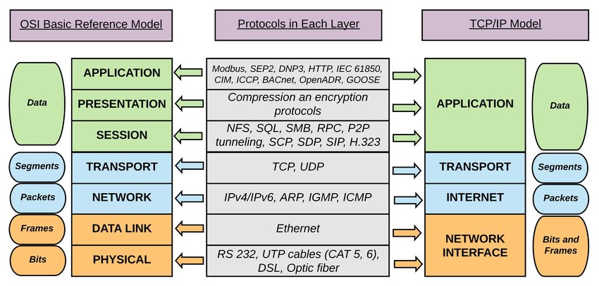
Comparison

Slide 67


Difference - OSI Model and TCP/IP Protocol Layers
OSI Model
&
TCP/IP Protocol Layer
OSI (Open System Interconnection) | TCP/IP (Transmission Control Protocol/ Internet Protocol)
It has 7 layers | It has 5 layers
OSI provides layer functioning and also defines functions of all the layers | TCP/IP model is more based on protocols and protocols are not flexible with other layers
Follows horizontal approach | Follows vertical approach
OSI model has a separate presentation layer | TCP/IP doesn’t have a separate presentation layer
OSI model has a problem of fitting the protocols in the model | TCP/IP model does not fit any protocol

Slide 68
Majors between OSI Model and TCP/IP Protocol Layers
OSI Model
&
TCP/IP Protocol Layer
OSI (Open System Interconnection) | TCP/IP (Transmission Control Protocol/ Internet Protocol)
Network layer of OSI model provide both connection oriented and connectionless service | The Network layer in TCP/IP model provides connectionless service
OSI provides layer functioning and also defines functions of all the layers | TCP/IP model is more based on protocols and protocols are not flexible with other layers
Protocols are hidden in OSI model and are easily replaced as the technology changes | In TCP/IP, replacing protocol is not easy
OSI model defines services, interfaces and protocols very clearly and makes clear distinction between them | In TCP/IP, it is not clearly separated its services, interfaces and protocols
In OSI model the transport layer guarantees the delivery of packets | In TCP/IP model the transport layer does not guarantees delivery of packets

Slide 69
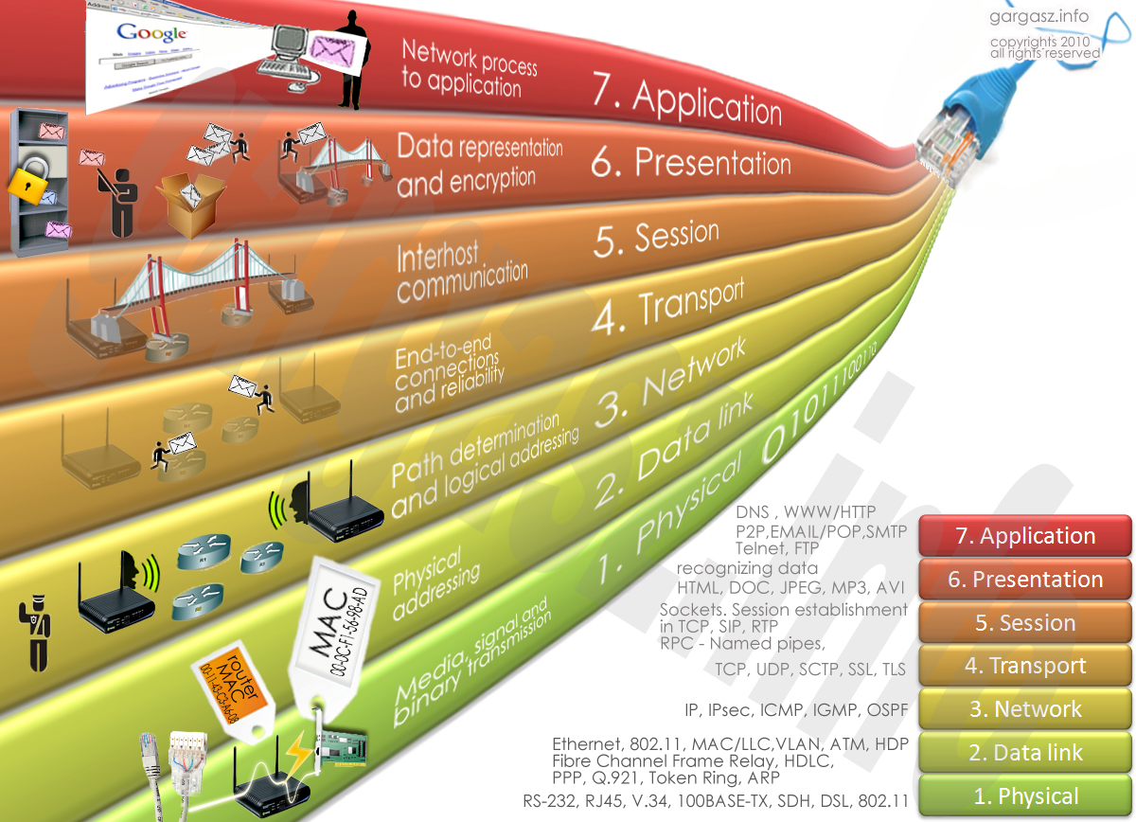
Protocol Layers: Summary

Slide 70
Delay, Loss & Throughput
Delay
As a packet travels from one node (host or router) to the subsequent node (host or router) along this path, the packet suffers from several types of delays at each node along the path.
Where
d_{nodal} = d_{proc} + d_{queue} + d_{tran} + d_{prop}
d_{nodal} | = | Total Delay
d_{proc} | = | Processing Delay
d_{queue} | = | Queuing Delay
d_{tran} | = | Transmission Delay
d_{prop} | = | Propagation Delay

Slide 71
Delay – Cont…
Processing Delay (d_{proc})
The time required to examine the packets header and determine where to direct the packet.
To check bit level error
Determine output link
Delay in terms of microseconds

Slide 72
Delay – Cont…
Queuing Delay (d_{queue})
A time to wait at output link for transmission.
Depends on congestion level of router.
If queue is empty, then delay will be zero.
If queue is full (heavy traffic) then delay will be long.
Delay in terms of microsecond to millisecond.

Slide 73
Delay – Cont…
Transmission Delay (d_{tran} = L/R)
An amount of time required for the router to transmit the packet.
It is depending on packet length(L) and transmission rate(R) of link.

Slide 74
Delay – Cont…
Propagation Delay (d_{prop}= d/s)
A time required to propagate from the beginning of the link to router B.
Depends on the length of physical medium(d) link and propagation speed(s) of link
Delay in terms of millisecond.

Slide 75
Sum
In this problem, we consider sending real-time voice from Host A to Host B over a packet-switched network (VoIP).
Host A converts analog voice to a digital 64 kbps bit stream on the fly.
Host A then groups the bits into 56-byte packets.
There is one link between Hosts A and B; its transmission rate is 2 Mbps and its propagation delay is 10 msec.
As soon as Host A gathers a packet, it sends it to Host B. As soon as Host B receives an entire packet, it converts the packet’s bits to an analog signal.
How much time elapses from the time a bit is created (from the original analog signal at Host A) until the bit is decoded (as part of the analog signal at Host B)?

Slide 76
Solution
Since this is a packet switched network, the data will be transmitted packet by packet. A packet is 56 byte and the analog to digital conversation rate is 64 kbps.
Thus the preparing time Tp for a packet is (56*8)/(64*1000)= 0.007 s = 7 ms.
The transition time Dtrans for a packet is (56*8)/(2*1000*1000) =0.000224 s = 0.224ms. Tprop = 10ms
Finally, the total time elapses from the time a bit is create until the bit is decoded is Tp+Dtrans+Tprop= 7+0.224+10 = 17.224 ms

Slide 77
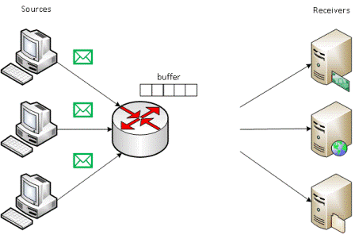
Packet Loss
Packet loss is the failure of one or more transmitted packets to arrive at their destination.
The loss of data packets depends on the switch queue/buffer. The loss of data packets increases with the increases in the traffic intensity.
It affects the performance
of the network.

Slide 78

Throughput
Throughput or Network Throughput is the rate of successful message delivery over a communication channel.
Throughput is measured in bits(data) per second (bit/s or bps)
server, with
file of F bits
send to client
link capacity
R_{s} bits/sec
link capacity
R_{c} bits/sec
Client

Slide 79
History of Computer Networks
1961-1972 : The development of Packet Switching
1972-1980 : Proprietary Network and Internetworking
1980-1990 : A Proliferation of Networks
1990s : The Internet Explosion
Recent Developments…

Slide 80
Outline - Revised
What is Computer Network? Connected each other
Advantages of Computer Network
Applications of Computer Network
Type of Computer Network LAN, MAN, WAN
What is Internet? Infinite nos. of connected computers across the world
What is Protocol? Set of Rules
The Network Edge Host-end system & edge router
The Network Core Circuit Switched & Packet Switched
Transmission Media Guided- Wired & Unguided-Wireless
Network Topologies Bus, Ring, Star, Mesh, Tree, & Hybrid
Protocol Layers OSI Layer & TCP/IP Layer
Delay, Loss & Throughput

Slide 81

Computer Networks (CN)
GTU #3150710
Prof. Maulik Trivedi
Computer Engineering Department
maulik.trivedi@darshan.ac.in
9998265805

